Slide 1
Analysis of Israeli restaurants in NYC
Coursera capstone project
Ela Markovsky

Slide 2
Introduction
The 2000 United States Census estimated that as many as 106,839 Israelis live in the United States, while other unsourced estimates say the number is much higher, around 500,000. New York City is the city where most Israeli-Americans reside. Immigrants tend to bring their cuisine with them and Israelis are no exception, evidenced by new Israeli restaurants constantly popping up in New York City.
In this project I plan to analyze Israeli restaurants in New York City and obtain the number of restaurants by borough, their ratings and the number of ratings they receive. This analysis would be valuable to people who consider opening a restaurant serving Israeli cuisine. This analysis will help determine whether there is a sufficient demand for such restaurants and in which borough it would be best to open one. This analysis would also be of interest to Israeli-Americans and anyone who enjoys Israeli cuisine.

Slide 3
Data and methodology
Data on names and locations was collected from Foursquare by making a basic request for restaurants labeled as “Israeli”.
Data was imported and analyzed using Python and pandas library. Data was visualized using matplotlib and folium libraries.
A separate dataset was used to assign each restaurant to the borough according to its zip code.
A separate premium request was made for each restaurant to get their rating and number of ratings.

Slide 4
Number of restaurants in each borough
Manhattan | 63
Brooklyn | 20
Queens | 2
Bronx | 0
Staten Island | 0

Slide 5
Average ratings
Average rating of all Israeli restaurants in NYC was 8.1
 | Rating | No. of Ratings
Brooklyn | 8.1 | 507
Manhattan | 8.1 | 430
Queens | 7.5 | 206

Slide 6
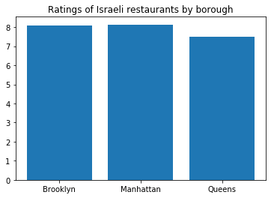
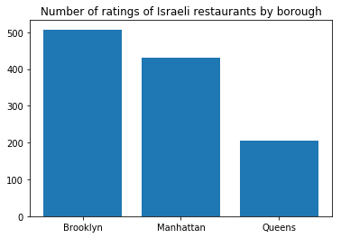
Average ratings

Slide 7
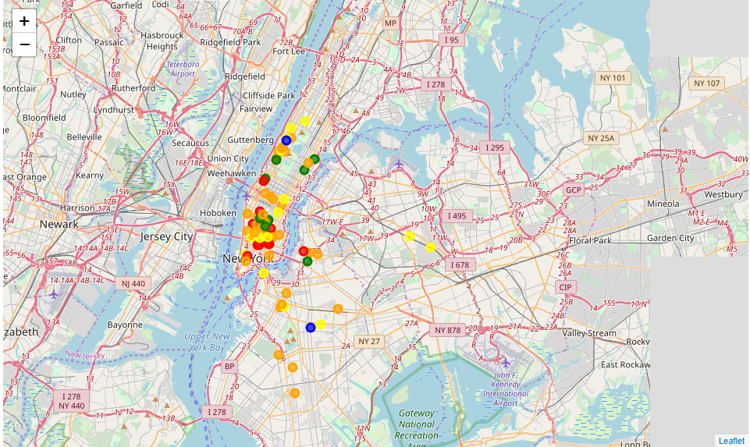
Visualization of restaurants on NYC map

Slide 8
Discussion
Most Israeli restaurants are in Manhattan, despite the large Israeli populations in Brooklyn and Queens.
Israeli restaurants are usually highly rated (average rating 8.1) and there is no significant difference in rating between boroughs.
Restaurants in Brooklyn had the most ratings on average, and Queens had the least.
Opening a restaurant in Brooklyn has the most potential. since there are much less restaurants there than in NYC, meaning a less saturated market, while there is a large Israeli population there. Moreover, restaurants in Brooklyn usually get a large number of ratings, which can be translated into a large number of visitors.

